Slide 1
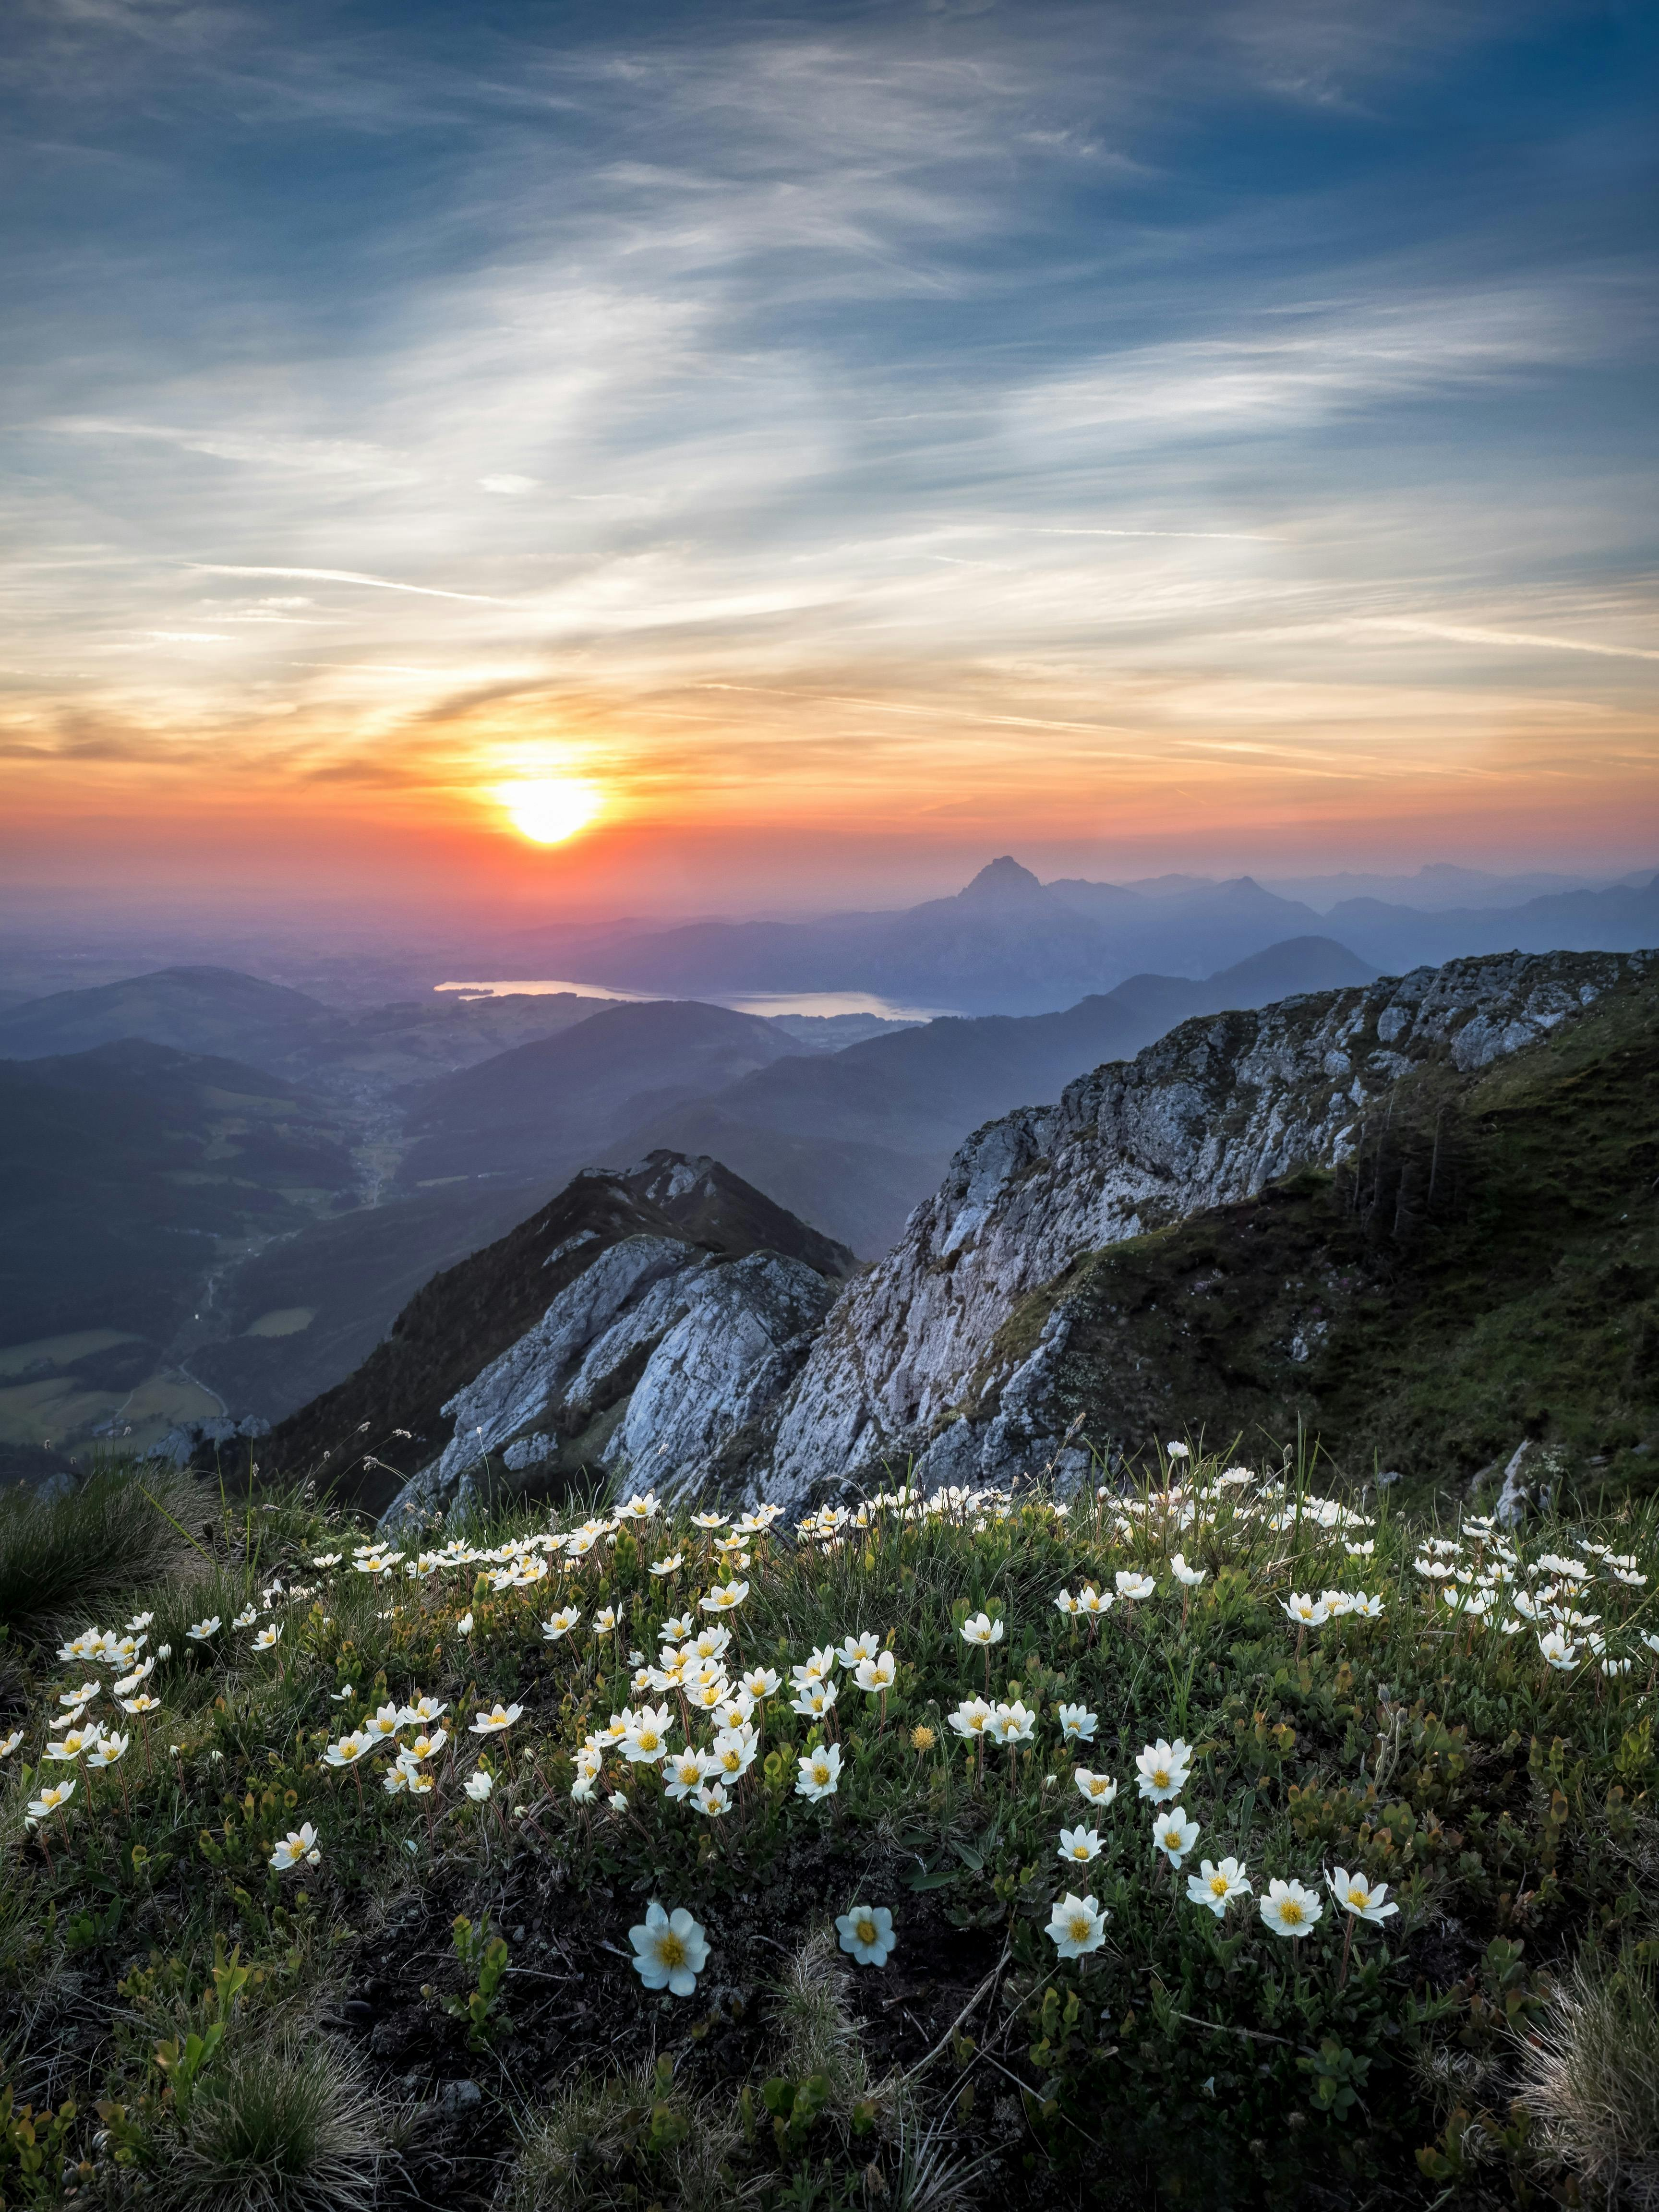
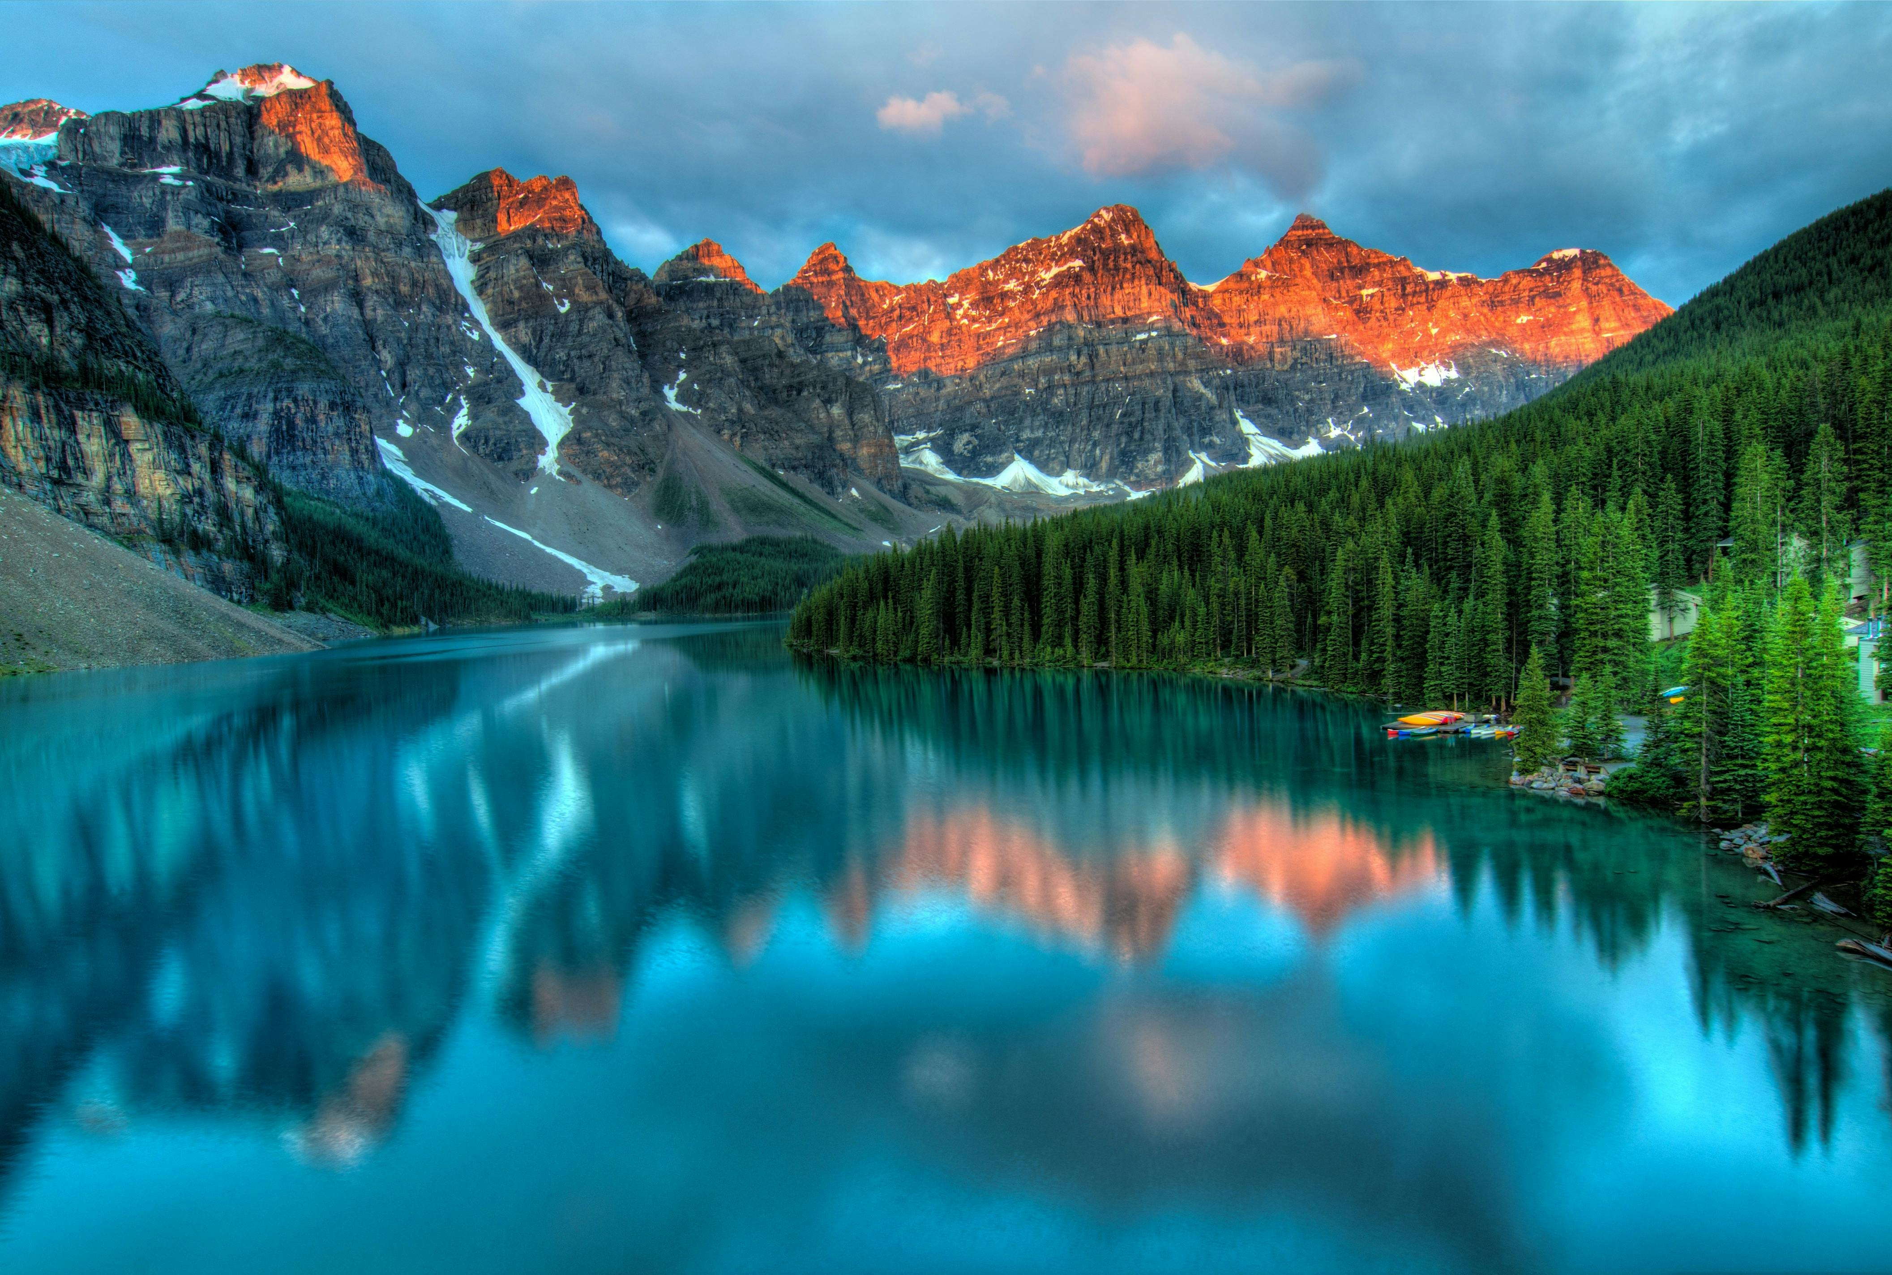
Natural Scene Image Classification with PyTorch
Tazinder Pal Singh

Slide 2


agenda
Project Overview​
Datasets
Methodology
Results
Improvements
Summary
References

Slide 3


Project Overview
Goal: Classify images of natural scenes into 6 categories
Categories: Buildings, Forest, Glacier, Mountain, Sea, Street
Tools: PyTorch, Python, Scikit-learn, Matplotlib

Slide 4

Dataset
Source: Kaggle
Total images: ~25,000 (150x150 pixels each)
Training set: 14,034 images
Testing set: 3,000 images
Prediction set: 7,000 images

Slide 5

Methodology
Data Preprocessing
Image normalization
Data augmentation (random horizontal flips)
Model Architecture
Convolutional Neural Network (CNN)
3 convolutional layers, 2 fully connected layers
Training Process
10 epochs
Adam optimizer (learning rate: 0.001)
Cross-entropy loss function

Slide 6
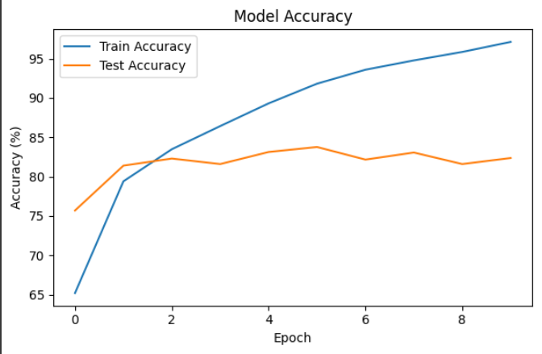
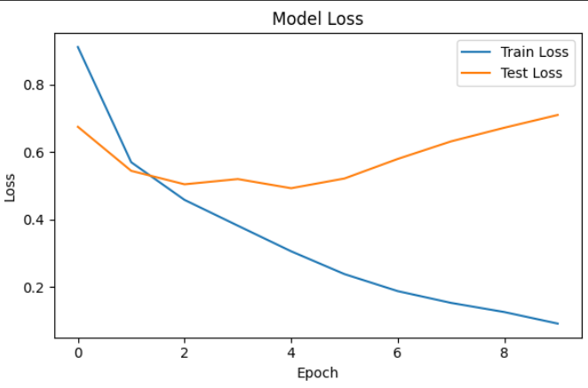
Results

Slide 7
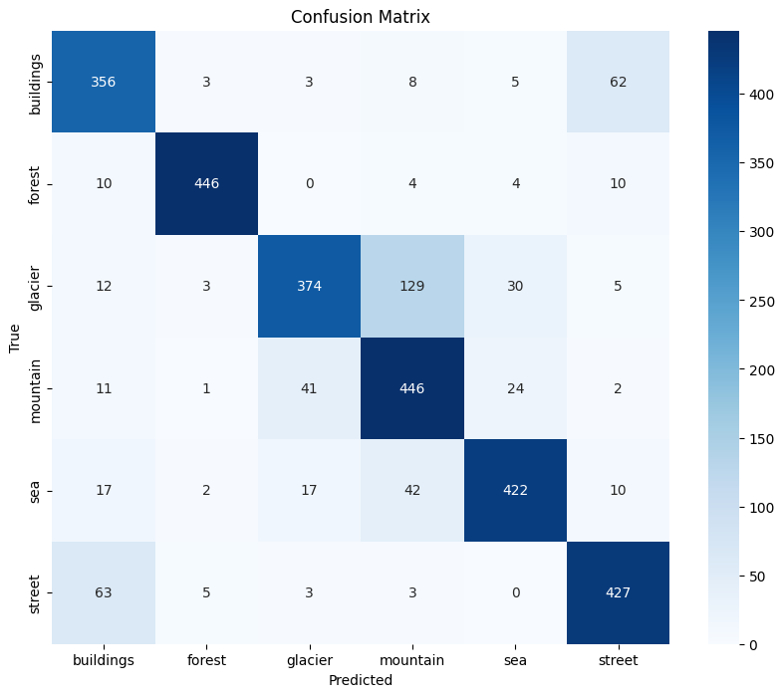
Confusion Matrix

Slide 8
Challenges and Findings
Data Loading: Resolved directory structure issues
Model Architecture: Simple CNN effective for this dataset
Training Process: 10 epochs balanced accuracy and training time
Performance Tracking: Comprehensive metrics provided valuable insights

Slide 9
Future Improvements
Advanced data augmentation techniques
Experiment with deeper architectures or transfer learning
Hyperparameter tuning
K-fold cross-validation
Visualization of model predictions and misclassifications
Utilize prediction set for real-world testing

Slide 10



Summary
Successful implementation of CNN for natural scene classification
Valuable experience gained in image classification and deep learning
Strong foundation for future computer vision projects
Demonstrated ability to apply AI techniques to real-world problems

Slide 11

Tazinder Pal Singh​​
1216160
AIM1 (24 S)
This Photo by Unknown Author is licensed under CC BY-SA

Slide 12


Slide 13
References
https://www.kaggle.com/datasets/puneet6060/intel-image-classification
https://www.pexels.com/search/beautiful%20nature/
https://www.pexels.com/search/agenda/

